Slide 1
Sub- Human Resource Management
Class – B.Tech
Sem – VII
By-
Prof. Priti Yamdagni

Slide 2
Human Resource Planning
The biggest challenge is the numbers. The numbers are just so large. But the issue is no different than the one (founder) Sam Walton faced. We have to focus on one associate at a time.
HRP is a process by which an organisation ensures that it has the right number & kind of people at the right place and at the right time, capable of effectively and efficiently completing those tasks that help the organisation achieve its overall objectives.
What is HRP?
 The process of Deciding what positions the firm will and how to fill them.
 The process of forecasting the supply and demand for human resources within an organisation and developing action plans for aligning the two.

Slide 3
E.W Vetter viewed human resources planning
as ―a process by which an
organization should move from its current manpower position to its desired
manpower position. Through planning management strives to have the right
number and right kind of people at the right places at the right time, doing things
which result in both the organization and the individual receiving maximum
long-run benefit.
According to Leon C Megginson human resources planning is an integrated
approach to performing the planning aspects of the personnel function in order to
have a sufficient supply of adequately developed and motivated people to
perform the duties and tasks required to meet organizational objectives and
satisfy the individual needs and goals of organizational members.

Slide 4
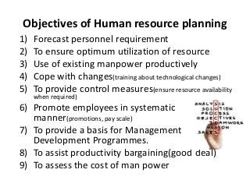

Slide 5
HR departments are responsible for the following tasks:
 Recruitment, Selection
 Evaluating, creating and administering compensation and benefits programs
 Training and professional development
 Employee manuals
 Time and attendance etc.
Planning:
 Business should always have a strategic plan.
 SP- identifies the company goals and objectives and communicates these goals.
 Develops a sense of ownership of the plan.
 Build consensus about where an organization is going

Slide 6
Importance of HRP
 Planning is important for HRM.
 Each Organization needs personnel with necessary qualifications, skills, knowledge, experience & aptitude.
 Need for Replacement of Personnel - Replacing old, retired or disabled personnel.
 Meet manpower shortages due to labour turnover - Indian Airlines, Gas Authority of India headless for 10 months.
 Meet needs of expansion / downsizing programmes - As a result of expansion of IT companies the demand for IT professionals are increasing. PSU‟s offering VRS to employees to retrench staff and labour costs. DOT.COMs firing staff.
 Cater to Future Personnel Needs - Avoid surplus or deficiency of labour. [OverstaffedRedeployment].
 Nature of present workforce in relation with Changing Environment - helps to cope with changes in competitive forces, markets, technology, products and government regulations.

Slide 7
HRP comprises A Four Steps Process
The first step is to develop a strategy planning which matches with the Organisations Vision, Mission and values.
 Increase the profit
 Satisfy the partners
 Finding new customers
 Developing quality products and tools
 Eliminate the non-profitable measures.
For example-The 2016's mission is You Must Be A STAR
S - Speed
T - Team
A - Approach
R - Results
The vision: Build, create the environment& culture that attracts, retains, and breeds the present and future leaders, expertise &innovators
The Core values
 Reward  Resourcing  Development  Employee relations Priorities:  Improve Customer Experience  Grow Revenue.  Improve Profitability & cash flow.  Create a great employee experience  Live our Values.

Slide 8
2. The second step is predicting Demand for HR
 Decrease costs
 Vacant jobs
 Train on new equipment. MRCET MBA
3. The third step is Determining HR Supply available
 DAP development action plan
 Improve the skills of employees
 Link with employees needs
 Analyze and choose the common needs
 Appraisal at the end of the year in developing the employees skills
 Replacement charts.

Slide 9
4 .The last steps is Formulating the Plans for Action:
Decisions with a shortage of employees: Selection, overtime, recruitment
Organizational Objectives & Policies:
 Downsizing / Expansion
 Acquisition / Merger / Sell-out  Technology up gradation / Automation
 New Markets & New Products
 External Vs Internal hiring
 Training & Re-training
 Union Constraints

Slide 10
Case Study
How FCO Meet Business Needs through Workforce Planning
The staffing needs of an organization change constantly. Without proper planning,
an organization may suffer from skills shortages. It may be unable to provide a
good service because it does not have sufficient staff with the right experience.
Workforce planning involves estimating the present and future staffing
requirements of the organization. It needs to take into account that:
existing employees may retire, resign or get promoted
new technology may change working methods and require different skill sets
More staff (or staff with different skills) may be needed to fulfill new
business or operational requirements.
The process helps the FCO to identify what skills it needs to deliver its strategic
objectives. It helps it assess the skills available within the existing workforce and
see where there might be gaps in the future. Workforce planning involves
thinking ahead to fit individuals with the right skills into different parts of the
organization.
The FCO has to undertake this planning in the context of the current political and
economic environment. Workforce planning can be a challenge. As an
organization with operations in countries across the world, the FCO has to ensure
balanced workloads for employees both within the UK and overseas. It faces the
challenge of rotating staff between different overseas postings.

Slide 11
What is HR Demand Forecasting?
HR Demand forecasting must consider several factors-both external as well as internal. Among the external factors are competition (foreign and domestic), economic climate, laws and regulatory bodies, changes in technology, and social factors. Internal factors include budget constraints, production levels, new products and services, organisational structure, and employee separations. Demand forecasting is common among organisations, though they may not do personnel-supply forecasting.
Reasons to Conduct Demand Forecasting
There are several good reasons to conduct demand forecasting. It can help:
quantify the jobs necessary for producing a given number of goods, or offering a given amount of services
(ii) determine what staff-mix is desirable in the future
(iii) assess appropriate staffing levels in different parts of the organization so as to avoid unnecessary costs
(iv) prevent shortages of people where and when they are needed most; and
(v) monitor compliance with legal requirements with regard to reservation of jobs.

Slide 12
HR Forecasting Techniques
HR Forecasting techniques vary from simple to sophisticated ones. Before describing each technique, it may be stated that organizations generally follow more than one technique. The techniques are:
1. Ratio-trend analysis
2. Regression analysis
3. Work-study techniques
4. Delphi technique
5. Flow models
6. Other forecasting techniques
1. Ratio-trend Analysis
This is the quickest HR forecasting technique. The technique involves studying·past ratios, say, between the number of workers and sales in an organization and forecasting future ratios, making some allowance or changes in the organization or its methods.

Slide 13
2. Regression Analysis
This is similar to the ratio-trend analysis in that forecast is based on the relationship between sales volume and employee size. However, regression analysis is more statistically sophisticated. A firm first draws a diagram depicting the relationship between sales and workforce size.
It then calculates a regression line – a line that cuts right through the center of the points on the diagram. By observing the regression line, one can find out the number of employees required at each volume of sales.
3. Work-study Techniques
Work-study techniques can be used when it is possible to apply work measurement to calculate the length of operations and the amount of labor required.
The starting point in a manufacturing company is the production budget, prepared in terms of volumes of saleable products for the company as a whole, or volumes of output for individual departments.
The budgets of productive hours are then compiled using standard hours for direct labor. The standard hours per unit of output are then multiplied by the planned volume of units to be produced to give the total number of planned hours for the period. This is then divided by the number of actual working hours for an individual operator to show the number of operators required.

Slide 14

4. Delphi Techniques
Delphi Technique Named after the ancient Greek Oracle at the city of Delphi, the Delphi technique is a method of forecasting personnel needs. It solicits estimates of personnel needs from a group of experts, usually managers. The human resource planning (HRP) experts act as intermediaries, summarize the various responses and report the findings back to the experts.
The experts are surveyed again after they receive this feedback. Summaries and surveys are repeated until the experts’ opinions begin to agree. The agreement reached is the forecast of the personnel needs. The distinguishing feature of the Delphi technique is the absence of interaction among experts.

Slide 15
5. Flow Models
Flow models are very frequently associated with forecasting personnel needs. The simplest one is called the Markov model. In this technique, the forecasters will:
1. Determine the time that should be covered. Shorter lengths of time are generally more accurate than longer ones. However, the time horizon depends on the length of the HR plan which, in tum, is determined by the strategic plan of the organization.
2. Establish categories, also called states, to which employees can be assigned. These categories must not overlap and must take into account every possible category to which an individual can be assigned. The number of states can neither be too large nor too small.
3. Count annual movements (also called ‘ flows’) among states for several time periods. These states are defined as absorbing (gains or losses to the company) or non-absorbing (change in position levels or employment status). Losses include death or disability, absences, resignations, and retirements. Gains include hiring, rehiring, transfer, and movement by position level.

Slide 16
4. Estimate the probability of transitions from one state to another based on past trends. Demand is a function of replacing those who make a transition.
There are alternatives to the simple Markov model. One, called the semi-Markov, takes into account not just the category but also the tenure of individuals in each category. After all, the likelihood of movement increases with tenure.
Another method is called the vacancy model, which predicts probabilities of movement and the number of vacancies. While the semi-Markov model helps estimate movement among those whose situations and tenure are similar, the vacancy model produces the best results for an organization.
Markov analysis is advantageous because it makes sense to decision-makers. They can easily understand its underlying assumptions.
They are, therefore, likely to accept results. The disadvantages include: (i) heavy reliance on past-oriented data, which may not be accurate in periods of turbulent change, and (ii) accuracy in forecasts about individuals is sacrificed to achieve accuracy across groups.

Slide 17
6 Other Forecasting Techniques
New venture analysis will be useful when new ventures contemplate employment planning. This technique requires planners to estimate HR needs in line with companies that perform similar operations. For example, a petroleum company that plans to open a coal mine can estimate its future employment needs by determining the employment levels of other coal mines.

Slide 18
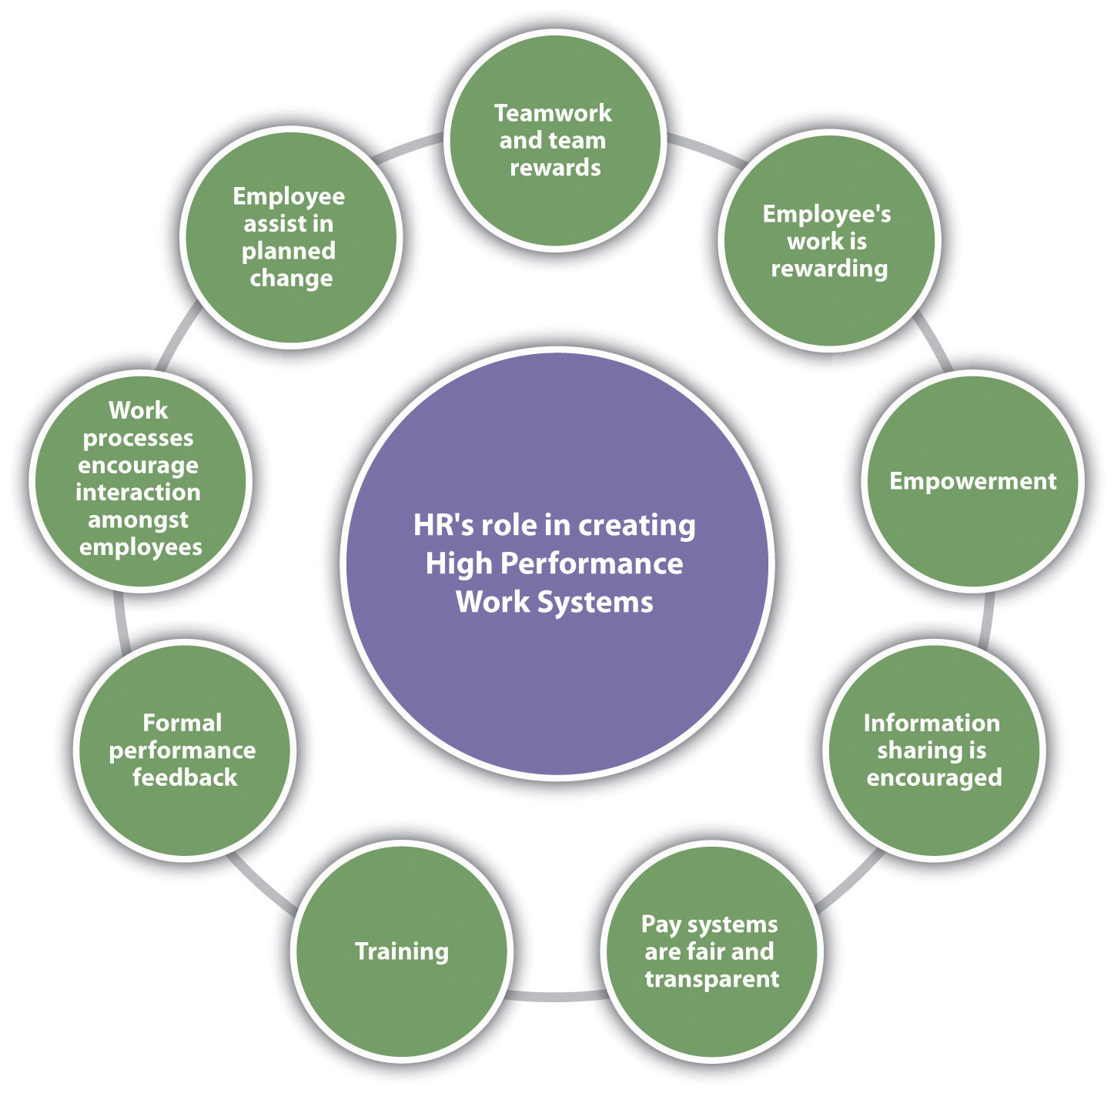

Slide 19
The HR plan contains the following activities:
(i) Recruitment,
(ii) Training and Re-training,
(iii) Productivity,
(iv) Redeployment, and
(v) Retention.

Slide 20
Redeployment takes the form of transfers. In case of estimation of surplus and not deficit for the entire organisation, then trade unions have to be consulted before going for retrenchment and redundancy. Redundancy plan includes provision for compensation, help in getting new jobs, and priority in filling future vacancies for retrenched employees.
Measures for Redeployment, Redundancy / Retrenchment:
(1) Outplacement:
Under this measure career guidance and retraining is provided to the prospective displaced employees so that they can be redeployed elsewhere in the organisation.

Slide 21
(2) Lay Offs:
Layoffs are because of recession in business, power failure, major breakdown etc. of temporary nature. Employees are called back when normal position is restored. Permanent layoff is because of liquidation of the company. The employees can be-absorbed elsewhere in the enterprise where vacancies exist as a result of retirement or death.
(3) leave of Absence without pay:
This is the method employed by the company to reduce the cost of labour and enable employee to pursue his self interest. It also helps the company to eliminate unnecessary jobs. This method helps employees to be aware of future changes.

Slide 22
(4) Work Sharing:
Under this method employees are given the opportunity to share jobs i.e. two employees working half time each. This is a temporary way to solve retrenchment problem.
(5) Reduced work Hours:
Under this method each employee work for less hours, receives less pay.
(6) Voluntary Retirement:
To get rid of overstaffing problems, the government of India has introduced a novel scheme known as Voluntary Retirement Scheme under the caption ‘Golden Handshake’ for its employees.

Slide 23
(7) Attrition:
Under this method the employees who are leaving the jobs at their own create vacancies. The vacancies are not filled, rather freeze and a ban on employment is imposed.
Retention Plan:
When organisations faced the shortage of some categories of employees they adhere to retention of the existing employees.
Retention pain covers the following:
Bringing the salary to the same level as exist in comparable enterprises preventing the employees to quit the organisation for better prospect in other organisations.
(2) Opportunities for career development is provided to the employees through training and development, by giving challenging assignment etc.

Slide 24
(3) More fringe benefits are offered.
(4) Better working conditions are provided.
(5) Extensive participation of employees in decision making is encouraged.
(6) Higher level jobs are offered to the existing employees deserving qualifications, skills and potentialities.
(7) Effective method for grievance redressal and conflict resolution is adopted.
(8) Better facilities for interpersonal relations are created.

Slide 25
Strategic human resource management (SHRM)
is the process involved in aligning human capital with the long-term goals of an organization.
Its main aim is to improve the performance of an organization.
SHRM is involved in processes that are future-oriented in the development and implementation of human resource programs involved in solving problems in business.
SHRM is founded on three major pillars, which include:
Human Capital - SHRM recognizes that human capital is not just a resource but an organization's assets that provide a competitive edge.
Planning - With proper planning, changes are achievable so long as they align with the needs and objectives of the organization
Business competition - The main aim of SHRM is to focus on ways that a firm can take an edge over its business competitors.

Slide 26
SHRM involves organizational goals in alignment with the available human capital. Fostering innovation, improving overall performance, and improving human fulfillment are the main goals of SHRM.
Purposeful hiring and effective communication are examples of SHRM. They both steer the organization towards its long-term goal. Effective communication fosters transparency and creates an open forum discussion where various concerns are addressed.
SHRM is used to create a framework that links the management of people and the development of practices that align with the long-term goals.
SHRM differs from HRM in the sense that it is involved in framing human resource strategies so that they direct the efforts of the employees to align with the organizational goal. SHRM is practiced by HR departments when they work with other departments within an organization to help understand the goals of each department and develop strategies that align with the organizational goals. It takes each department to work together to reach the goals of an organization. In this sense, SHRM is a partner in organizational success.

Slide 27
What is workforce diversity?
Before you can start managing diversity in the workplace, you have to know what it is. And the definition may surprise you.
Diversity is anything that makes people different from one another. I’m sure you know you shouldn’t discriminate based on race, gender, national origin or disability. But there’s more.
Religion, age, sexual orientation, citizenship, political affiliation or opinions, military service, mental and physical conditions, personality, education, favorite sports team – all of these fall under the umbrella of diversity, which, if not managed correctly, can open the door to charges of discrimination or employee relations matters.

Slide 28
What are the benefits of diversity in the workplace for employees?
Conflict reduction
Within a diverse workplace, employees can better understand each other's differences.
This will often help to reduce conflicts between even the most different team members; and will often unite people with a common purpose rather than divide them.
Increased confidence
​When employees' recognise that differences are embraced and celebrated in an organisation, they are likely to also be more confident in their own unique qualities.

Slide 29
Encouraging diversity can help to boost confidence and performance from individual team members, who may be more easily able to express their ideas, become closer to their colleagues and enjoy and take pride in their work.
Boosting employee engagement
​Employees are far more likely to perform well in an environment where diversity and inclusion are top priority.

Slide 30
What are the benefits of diversity in the workplace for employers?
Increased range of ideas.
​One of the key benefits of diversity in society is the vast range of ideas that can be explored.
Diversity in the workplace will often result in a much broader spectrum of creativity, from people with different backgrounds, skills and experiences.
A wider range of different perspectives will be highly beneficial across all teams; from marketing to finance.

Slide 31
Increased employee engagement
​Generally speaking, employees who feel included and wanted will be more engaged and motivated to do well.
In turn, a more engaged team will often yield better team performance; making it a win-win for employers.
Boosts company reputation & simplifies recruitment processes
​Diversity in the workplace will help to build a great reputation for the company; especially important when you are looking to hire and retain talent.

Slide 32
Especially in terms of graduate recruitment, D&I can play a huge role in attracting candidates to your business; if done well, it can also help you stand out from the bigger firms.
Wider talent pool to choose from
​Companies that only hire men, for example, are limiting themselves to the skills of half the population, this is just one of the many benefits of gender diversity in the workplace.
Helps you to understand your customers better
​Having a more diverse team will help your company gain a broader understanding of your customers, what they want and what they look for.

Slide 33
Who knows? Your company could be missing out on a huge group of potential customers that could be explored by hiring more diversely.
Reduce employee turnover
​Companies with a diverse workforce will tend to retain employees for longer, because ultimately employees who feel accepted and valued will be much less likely to leave.
Likewise, companies who clearly value career development, and really care about their employees, will tend to have a much higher retention rate than those who don't.

Slide 34
Marriott International Industry: Hospitality
In a close second place on DiversityInc's Top 50 Companies, Marriott recently launched their Serve 360 plan, whereby they invested $5m in order for women, people with disabilities, veterans, refugees and more to learn hospitality skills.
Not every company will be able to afford $5m; but it does point to the value of investing in professional development.

Slide 35
Accenture PLC Industry: Professional Services
Accenture is often ranked within the top companies for diversity (Thompson Reuters' 2018 Diversity and Inclusion Index ranked Accenture as it's no.1 most diverse company), and though this is largely due to gender representation within their workforce, they have also been applauded for encouraging the inclusion of many different groups.
Diversity training within the company is broken into three different categories; 1) Diversity Awareness, to help people understand the benefits of working with a diverse organisation,
2) Diversity Management, to help team leaders to successful manage diverse teams and
3) Professional Development, to enable minority groups to develop valuable new skills.

Slide 36
Challenges of diversity in the workplace
Communication barriers
Hiring employees from a range of cultures and backgrounds has fantastic benefits for businesses; but can occasionally result in communication or language barriers within a team.
This can sometimes lead to frustration amongst employees and productivity loss. Embracing Business Diversity: Is Technology the Answer?

Slide 37
Employee requirements
Whether it's a VISA or specific cultural requirements, hiring employees from different countries can be tricky; especially if you are a relatively young company.
As well as posing a logistical challenge, it's important to remember that these accommodations can also sometimes be an added business cost to factor into your hiring plans.
Gender equality issues
Salary inequality between men and women has been a huge topic of discussion in recent years. Individuals that are treated unequally can become demotivated and often choose to leave, causing increases in staff turnover.

Slide 38
Generational differences
In teams where there is a wide age range, especially if the company is recruiting graduates, there many be some generational differences or generation gaps.
This could potentially hinder discussions on certain subjects; millennials account for the majority of UK workers, which is evolving today’s corporate culture.
Conflicting beliefs
Conflicts can arise in the workplace due to differences in religious, political or cultural beliefs, and unfortunately discrimination and prejudice still occurs in some corporate environments.

Slide 39
Disability discrimination
The workplace can be tough for employees with a physical or mental disability.
In a recent study on disability and employment 12% of employers are concerned that disabled employees will take more time off work and 19% believe that it is expensive to hire individuals with a disability due to costs involved in adapting the workplace.
Isolated individuals
Sometimes employees can feel left out or isolated when groups of other individuals with similar backgrounds and characteristics, form 'cliques' or social circles.

